Slide 1


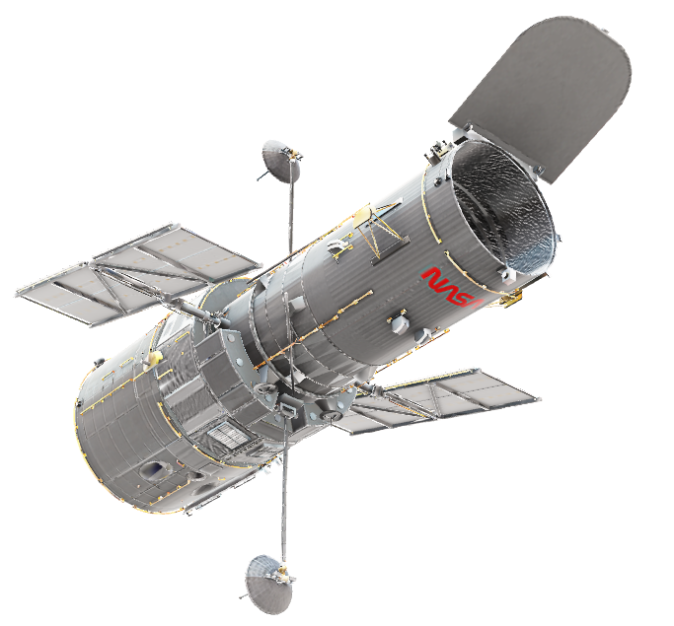
Project Gaia
Monitoring soil health from space
Dong-Yoon Kim, Woo-Young Park, Jin-Sung Kim, Su-Min Oh, Alfred Cueva
Seoul National University, Seoul, Korea
2022.11.17

Slide 2
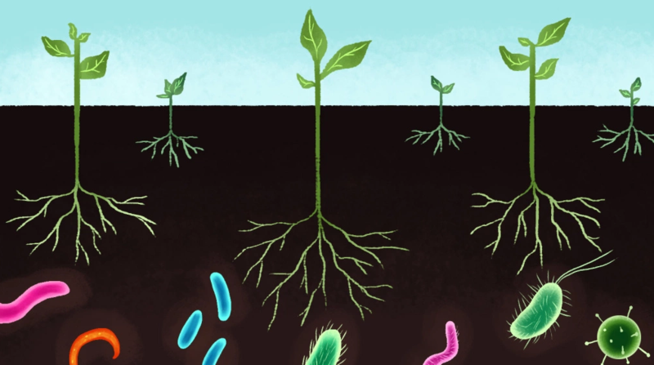
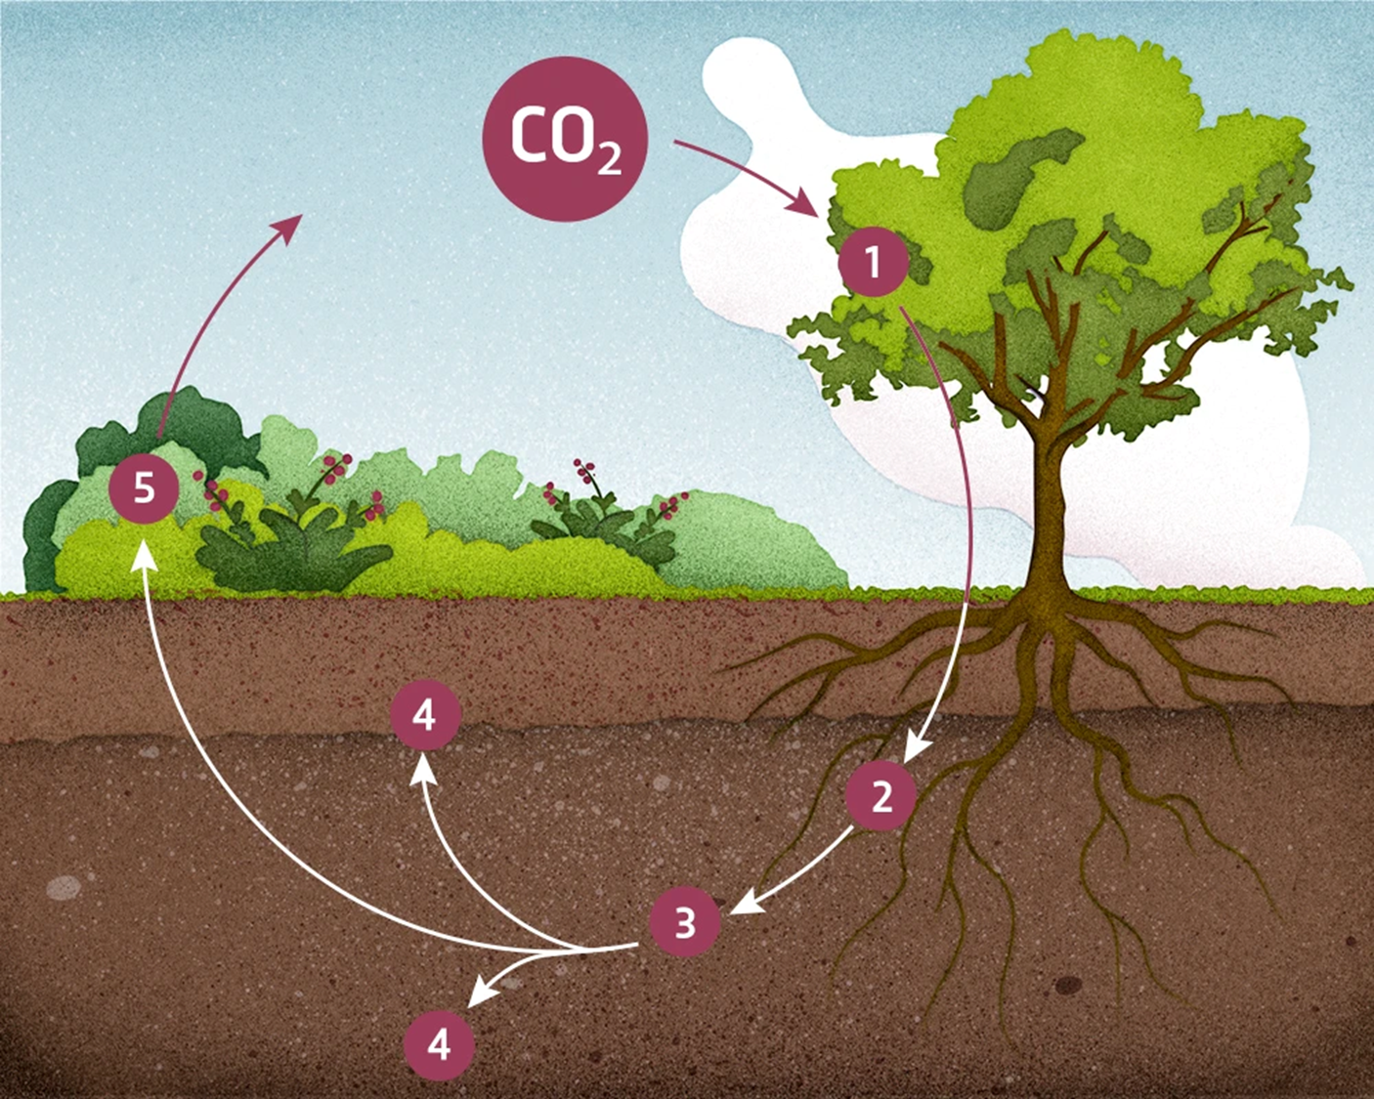
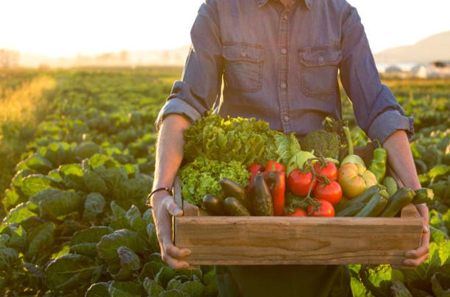
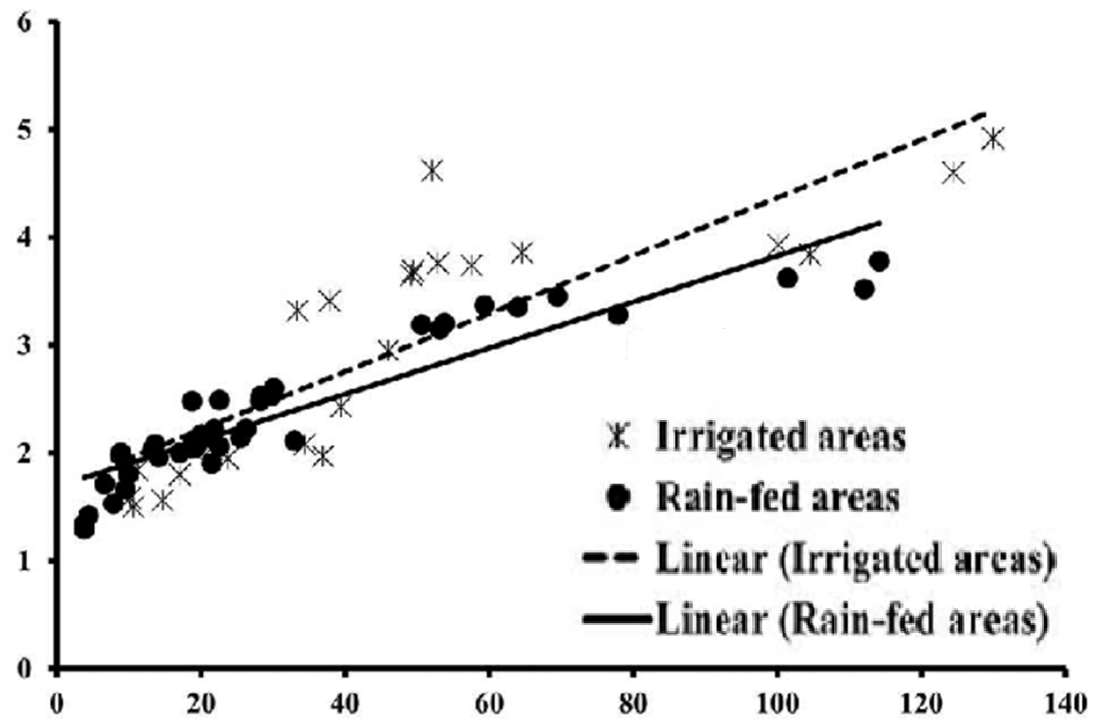
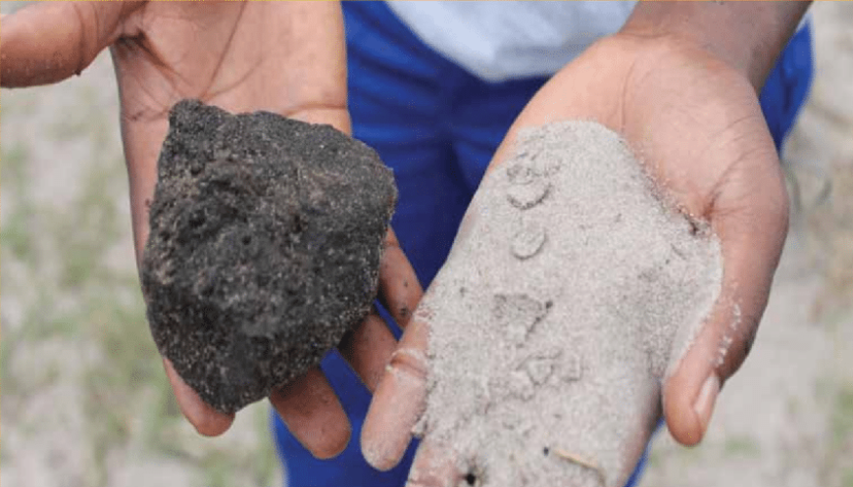
Introduction
Importance of Soil Health
95% of the food we eat comes from topsoil
[1] UNFAO, 2019
Soil is the largest terrestrial carbon sink
[2] Global Change Bio, 1997
Microbe biodiversity in soil helps crop growth
[3] Plant Sci, 2017
Soil Organic Carbon(SOC) = Soil Health
[4] Soil Sci, 2017
SOC improves
Soil structure
Biodiversity
Nutrient cycling
Water retention
Pollutant filtration
Crop productivity
Yield (Mg ha⁻¹ yr⁻¹)
High SOC
Low SOC
SOC (MgC ha⁻¹)
Notes:
1st box:
95% of the food we eat comes from __inches of top soil (while showing with finger how fragile)
Soils with high microbial abundance and diversity can support pathogen suppression, increase nutrient availability for crops
soils contain about three times more C than vegetation and twice as much as that which is present in the atmosphere
2nd box:
It includes many, many types including some you might know : peptides, saturated chains, lipids, aromatic, polysaccharides etc
3rd box:
One third of the world’s terrestrial land is tended farmland and by increasing just 0.4% of their SOC we can save this much water, making it robust in climate change induced drought and
Can sequester enough CO2 from the atmosphere to curb the Keeling Curve
Why is soil health important? (1. 90% of world's food source comes from 40cm of topsoil, 2. soil health helps to regulate water storage in terrestrial land, 3. soil holds the 2nd largest carbon stock in the world, more than the plants above it)
What is soil health? (Soil health is most dominantly determined by SOC because SOC helps to harbor microbial life, improve SWHC, aids plants taking up nutrients etc, basically the difference between sand and lush soil is SOC)
SOC is endangered because of unsustainable massive scale industrial farming practices (over the past 40 years, UNFAO has surveyed that global farmland SOC decreased by 70%)
SOC is the biggest source of terrestrial carbon storage and with 5 billion hectares of manageable farmland (third of global land area), even a 0.1% SOC increase over 5 years can hugely curb the CO2 build up curve (include graph to illustrate this calculation)

Slide 3
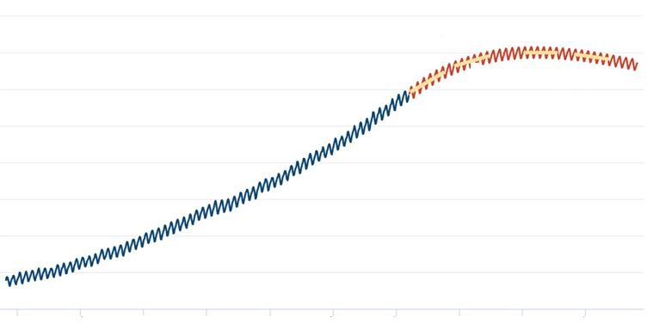
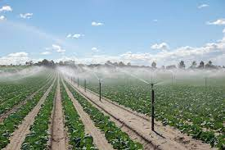
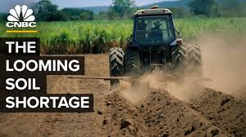
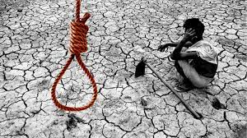
Impact of SOC
If SOC increase by 0.4%?
[5] IUCN, 2020
440
[6] Carbon Brief, 2022
420
400
Rising CO₂ due to humans
CO₂ sequestration
by soil
380
Atmospheric CO₂ (ppm)
360
340
320
300
1960
1970
1980
1990
2000
2010
2020
2030
2040
2050
37 trillion liters of extra water stored
= 15 million Olympic swimming pools
60 trillion kg of extra carbon stored
= 2 years of Global Carbon Emission
Global Issue of SOC degradation
[20] Soil Mapping and Process Modeling for Sustainable Land Use Management, 2017
[7] UNCCD, 2020
[21] National Crime Records Bureau, 2021
Unsustainable farming
Inadequate fertilizer
Overgrazing etc.
SOC depleted globally
By 2050, likely 90% of global topsoil degradation
Farmer suicide rate ↑↑↑ (300,000 in India alone) due to harvest < debt
Notes:
SOC is not something that you can just spray but it comes from decades and centuries of organic matter stacking (nature) but they deplete so so fast

Slide 4
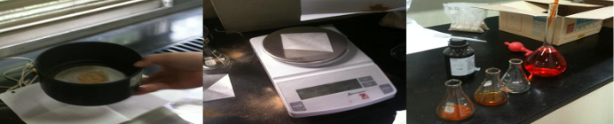
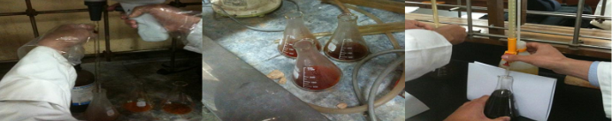
Importance of SOC estimation
Soil degradation prevention
Enforce Pro-Soil Policy
[22] Nature 601, 503-504 (2022)
[9] UNCCD COP15, 2022
SOC takes very long time to build up
↑ ↑ ↑ SOC → ↑ ↑ ↑ Incentive
Identify stressed areas before it’s too late
Monitor food security
“Healthy Soils Program” in California, US
“4p1000 initiative” in France
“Eco-farm incentive” in Japan
Current Method to measure SOC → Walkley-Black (WB) test
Send soil to lab
Sieve soil
Weigh
Add K₂Cr₂O₇ solution
Add conc. H₂SO₄
Left at room temp.
Titrate with FeSO₄ →SOC
Too slow, require dangerous chemicals and laboratory setting
→ Not scalable → Need to monitor SOC at global scale and at real-time
[11] Soil & Man., 2007
Notes:
Problem definition
- SOC drop is not noticeable at first but below a certain point the crops and plants above will suffer reduced yield, the soil is unable to hold water even if there is rain etc
- On top of that SOC cannot be restored to healthy levels when SOC drops too much
- So SOC needs to be monitored at huge scale globally to both aid SOC preservation efforts by governments (in terms of incentives when farmers raise the SOC of their farmland) and to warn nations of dangerous SOC levels at real-time
So farmers would want to cut cost on soc monitoring, helping to reduce this cost is helpful and impactful
So we need cost-effective solution to monitor SOC for environment, food security in the future

Slide 5
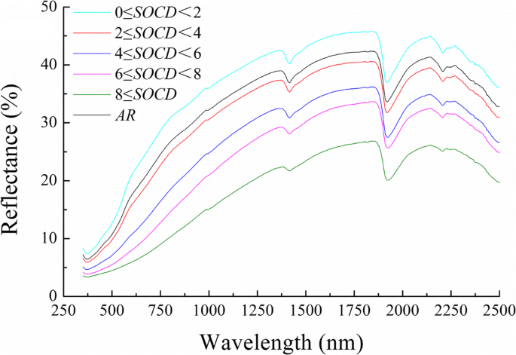
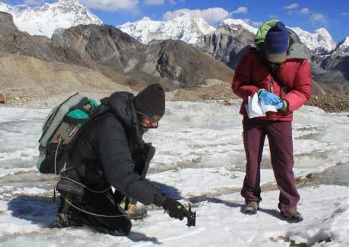
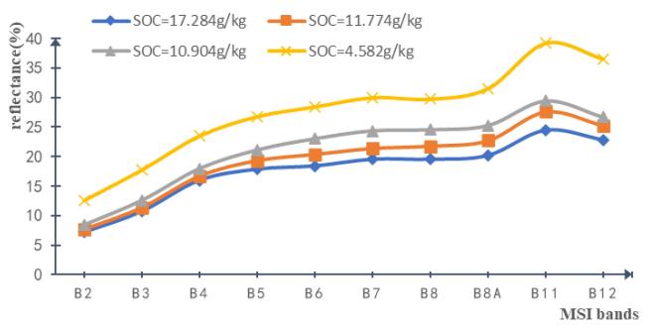
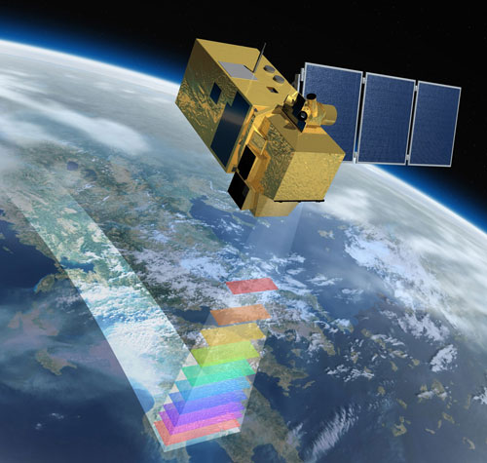
Related Works to solve SOC measurement
Hand-held spectroradiometer
Optical Characteristic of SOC
Hi-Res NG Spectroradiometer
[12] Int. Soil & Water Cons. Res. 2020
Reading Spectral Reflectance to determine SOC
Spectroradiometer extremely expensive ~ $100,000
Common farmers cannot afford
Not a scalable solution
Increase in SOC
Multispectral Satellite Imagery (MSI)
[13] Remote Sens. 2021
Scalable solution as Sentinel-2 images over entire Earth surface and open-source
Not accurate enough with R² = 0.5712 between predicted and actual SOC
Increase in SOC
…
10 discrete bands instead of continuous spectrum
Sentinel-2 Satellite with revisit time of 5 days Imaging the whole Earth
Notes:
Related works
- Current methods of assessing SOC utilize chemical tests (Walkley-Black test) but is time-consuming, expensive and not scalable
- There has been efforts to use portable on ground spectroscopy but these insturments are very expensive (the most portable one is the size of a carrier bag and costs 1억원)
- Taking inspiration from the spectroscopy method multi-spectral imagery satellites have been used to do this but massively lack accuracy due to ground being covered with vegetation, not enough information
Also mention that this won’t work if there is vegetation and clouds

Slide 6
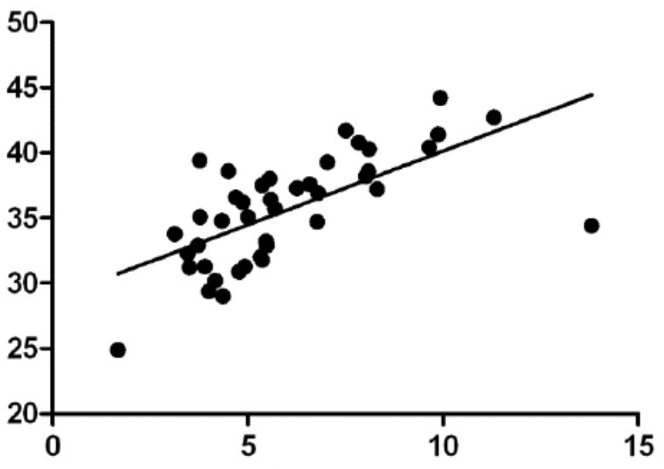
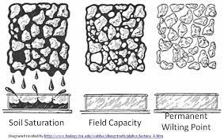
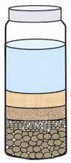
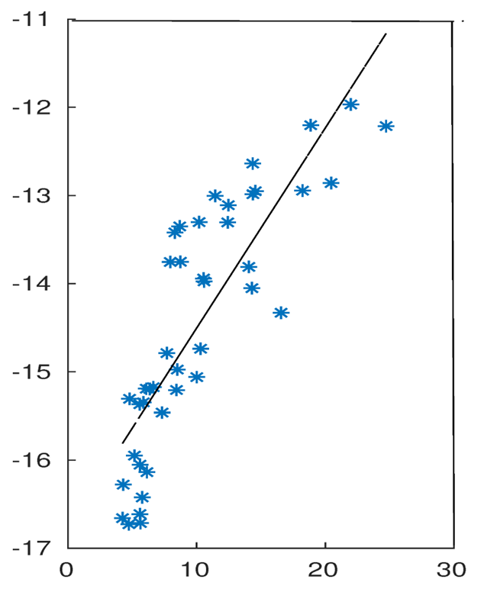
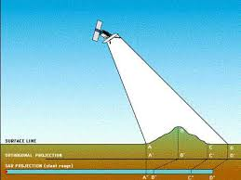
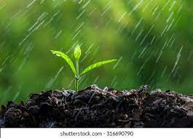
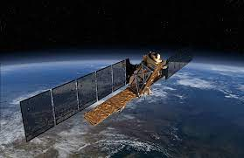
Our Strategy
Approach 1 (Hybrid Remote Sensing)
SOC ↑↑↑ → Soil Water Holding Capacity (SWHC)↑↑↑
SWHC
Soil Texture
Sentinel-2 MSI
H₂O
ML regression model to predict SOC level
SWHC (%)
+
+
Clay
Silt
Improve
Accuracy!
Sand
[14] Int. J. Ecol. Environ. Sci, 2009
SOC (%)
Simple, Cheap → Anyone (farmers etc.) can test
Approach 2 (Full Remote Sensing)
Sentinel-1
Synthetic Aperture Radar (SAR)
Sentinel-2 MSI
SAR b4 rain
Rain
SAR after rain
ML
Reg.
+
Backscatter_{VV} (dB)
More accurate than just Sentinel-2
Radar
Antenna
Surface
Soil Moisture (%)
Difference of Soil Moisture b4 and after rain can give us idea how well soil retains water
[15] Remote Sens. 2020
Notes:
Approach
- we use 3 main features to predict the SOC
- 1.Sentinel-2 satellite multispectral imagery can provide 13 discrete spectral information at resolution of 20m. Here we filter our satellite images based on NDVI and BSI which shows us how bare the soil is (if it is covered, the satellite measurement is wrong)
- 2.We include not just average precipitation of the region but also the rainfall over the are for 10 days leading to the date of satellite image acquisition
- 3.SWHC is highly dependent on SOC hence along with sentinel satellite multispectral imagery, we use rudimentary SWHC measuring setup to measure SWHC.
- Also taking inspiration from SWHC we use Synthetic Aperture Radar to measure the soil moisture before and after a rainfall event and add that as a feature.
- We visited farmlands in 이천 to collect topsoil samples and used Walkley-Black test to record label values of the ML algorithm
- We input all these data (1,2,3) into ML algorithm and predict SOC level. This is called remote sensing
Also mention the advantage of S1 not being tackled by clouds

Slide 7
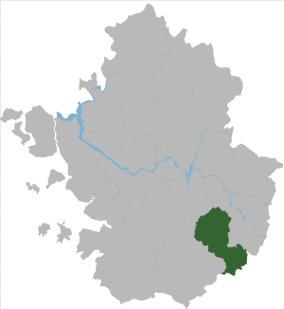
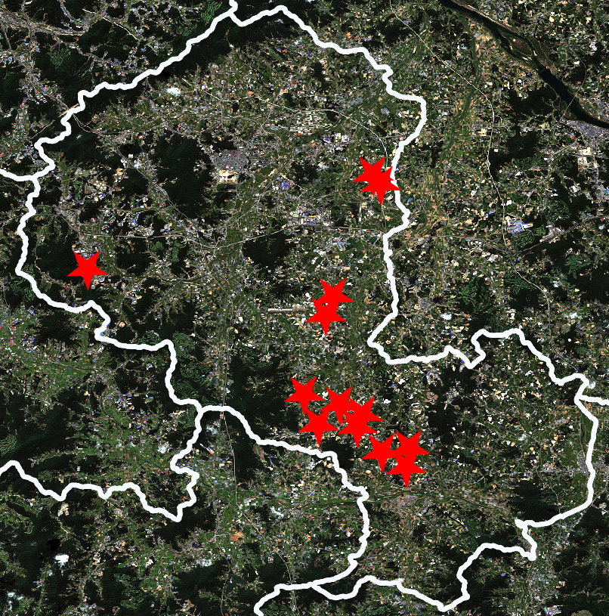
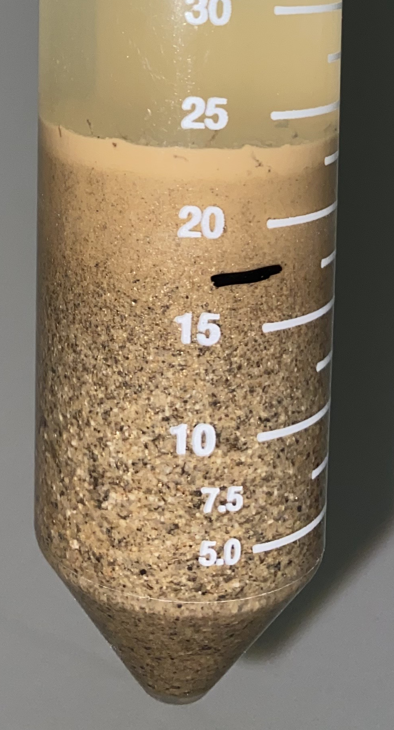
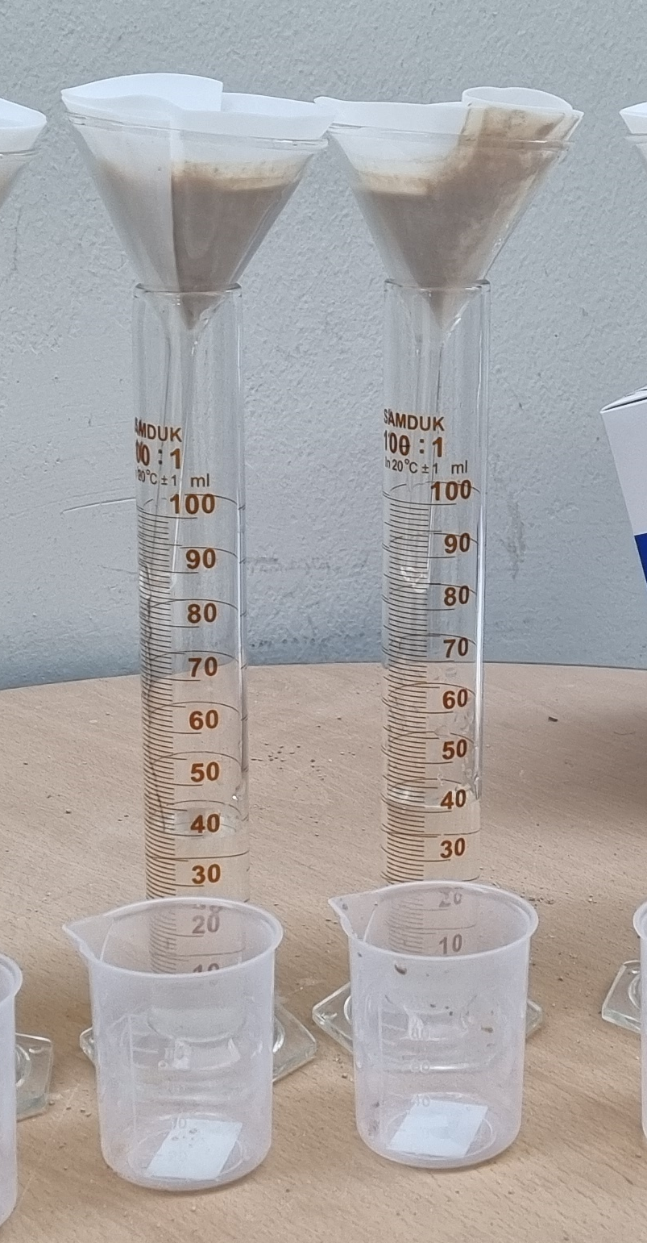
Methods
Sentinel-2 MSI
Sentinel-1 SAR
Soil Sample
93 Samples according to Surv. Manual [17]
Cloud Filtering
Filtering for pairs of images with rain in between
경기도
이천
Preprocessing to remove atmospheric influence
Preprocessing to remove noise and terrain correction
Soil Moisture Calculation [16]
Dying, Sieving
ST
SWHC
Filtering for images with
↓↓↓ Vegetation (NDVI) and↑↑↑ Bare Soil (BSI)
Soil Data (ST, SWHC)
WB Test @NICEM
ML Regression (PLSR, SVM, RF)
Glossary
MSI: Multi Spectral Imagery
SAR: Synthetic Aperture Radar
NDVI: Normalized Difference Vegetation Index
BSI: Bare Soil Index
SWHC: Soil Water Holding Capacity
ST: Soil Texture
WB: Walkley-Black Test
NICEM: 농생명과학공동기기원
PLSR: Partial Least Squares Regression
SVM: Support Vector Machine
RF: Random Forest Regression
Predicted SOC
Actual SOC
R² for different models and datasets
Notes:
Label making target feature (label) had to do this as there was no open-source soil data so had to collect them

Slide 8
Result
Raw Sentinel-2 Image (Resolution = 20m)
Models | SVM | PLSR | RF
Train R² | 0.22 | 0.48 | 0.70
Test R² | 0.21 | 0.30 | 0.52
Super-resolution (Resolution = 10m)
Models | SVM | PLSR | RF
Train R² | 0.57 | 0.38 | 0.69
Test R² | 0.33 | 0.25 | 0.38
Approach 1
(MSI + SWHC + ST)
Approach 2
(MSI + SAR)
Only MSI
Test R² = 0.52
Test R² = 0.83
Test R² = 0.74
Similar results with previous works [13,18,19]
Most Important Feature: B11 (1610 nm)
60% Accuracy Increase
Feature Importance rank of ST and SWHC data: 1~4th out of 22
42% Accuracy Increase
Feature Importance rank of SAR data: 6th out of 19

Slide 9
Discussion and Conclusion
Discussion
Improvements
MSI-only data showed highest feature importance for B11 (1610 nm) → Makes sense because this wavelength is due to hydrophilic materials of SOC [23]
Approach 1 result → ST was more important for SOC prediction than SWHC
Approach 2 result → Predictive power of SAR data is less than expected
Hyperspectral satellite imagery instead of multispectral images but none are open-source and monitoring whole globe
New satellite imagery with higher spatial resolution is crucial because there exists smalls farmlands (<20m) especially Korea
SAR data can be improved with determination of soil roughness
Conclusion
Approach 1 is cheap and easy able to accurately determine farmer’s SOC:
Implementation:
Farmer measure ST and SWHC
Send data to operator
Add MSI data
SOC determined
Approach 2 is less accurate than approach 1 but it is full-remote sensing → Robust means of global monitoring
Implementation:
MSI + SAR
Global Monitoring
Danger Area Detected
Check with Approach 1
Detect & Prevent soil degradation → Improve agriculture,
Monitor soil carbon sequestration → Help mitigate climate change
Notes:
Use NDVI during peak growing season to add into our features (this alone is very inaccurate) DOI: 10.1080/10106049.2017.1381179

Slide 10
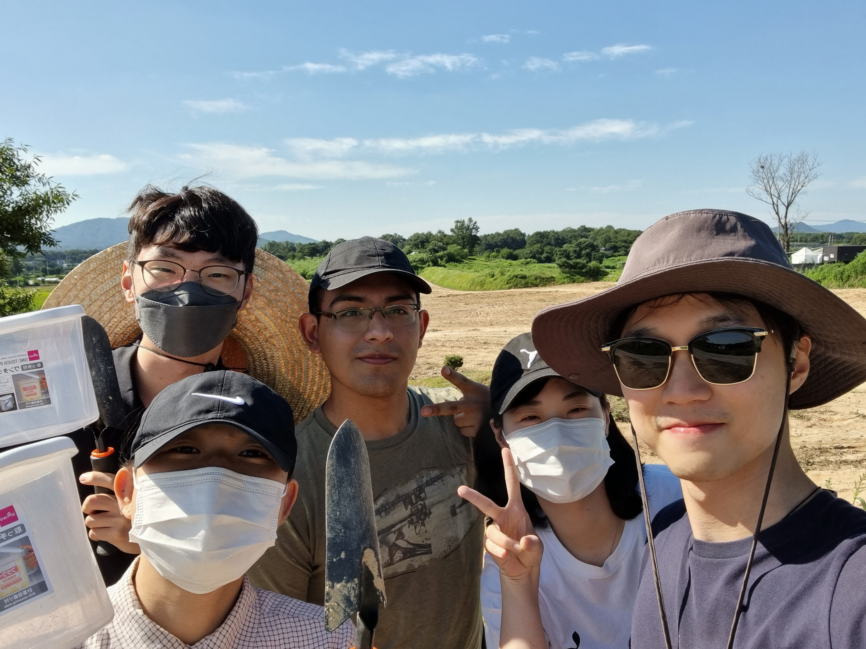
Thank you!
Any questions?

Slide 11
References
Organization, A. F. &. (2019). The State of Food and Agriculture 2019: Moving Forward on Food Loss and Waste Reduction. Food & Agriculture Organization.
Jacoby, R., Peukert, M., Succurro, A., Koprivova, A., & Kopriva, S. (2017). The Role of Soil Microorganisms in Plant Mineral Nutrition—Current Knowledge and Future Directions. Frontiers in Plant Science, 8.
BATJES, N., & SOMBROEK, W. (1997). Possibilities for carbon sequestration in tropical and subtropical soils. Global Change Biology, 3(2), 161–173.
Newcomb, C.J., Qafoku, N.P., Grate, J.W. et al. Developing a molecular picture of soil organic matter–mineral interactions by quantifying organo–mineral binding. Nat Commun 8, 396 (2017).
Wiesmeier, M., Urbanski, L., Hobley, E., Lang, B., von Lützow, M., Marin-Spiotta, E., van Wesemael, B., Rabot, E., Ließ, M., Garcia-Franco, N., Wollschläger, U., Vogel, H. J., & Kögel-Knabner, I. (2019). Soil organic carbon storage as a key function of soils - A review of drivers and indicators at various scales. Geoderma, 333, 149–162.
Wiesmeier, M., Urbanski, L., Hobley, E., Lang, B., von Lützow, M., Marin-Spiotta, E., van Wesemael, B., Rabot, E., Ließ, M., Garcia-Franco, N., Wollschläger, U., Vogel, H. J., & Kögel-Knabner, I. (2019). Soil organic carbon storage as a key function of soils - A review of drivers and indicators at various scales. Geoderma, 333, 149–162.
IUCN World Conservation Congress, 2020
Richard, Chris J, Spencer L., Ralph K., Guest post: How the Keeling Curve will need to bend to limit global warming to 1.5C, Carbon Brief, 2022
Organization, A. F. &. (2022). Drought in Numbers 2022. Food & Agricultural Organization
Aleminew, A., & Alemayehu, M. (2020). Soil Fertility Depletion and Its Management Options under Crop Production Perspectives in Ethiopia: A Review. Agricultural Reviews, OF.
De Vos, B., Lettens, S., Muys, B., & Deckers, J. A. (2007). Walkley?Black analysis of forest soil organic carbon: recovery, limitations and uncertainty. Soil Use and Management, 23(3), 221–229.
Lazaar, A., Mouazen, A. M., EL Hammouti, K., Fullen, M., Pradhan, B., Memon, M. S., Andich, K., & Monir, A. (2020). The application of proximal visible and near-infrared spectroscopy to estimate soil organic matter on the Triffa Plain of Morocco. International Soil and Water Conservation Research, 8(2), 195–204.
Wang, K., Qi, Y., Guo, W., Zhang, J., & Chang, Q. (2021). Retrieval and Mapping of Soil Organic Carbon Using Sentinel-2A Spectral Images from Bare Cropland in Autumn. Remote Sensing, 13(6), 1072.
Robinson, Michael & Al, Suad. (2009). An Assessment of Rangeland Soils on the Saiq Plateau, Jebel Akhdar, Oman. International Journal of Ecology aRemote Sens. 2020, 12(1), 72
Ezzahar, J., Ouaadi, N., Zribi, M., Elfarkh, J., Aouade, G., Khabba, S., Er-Raki, S., Chehbouni, A., & Jarlan, L. (2019). Evaluation of Backscattering Models and Support Vector Machine for the Retrieval of Bare Soil Moisture from Sentinel-1 Data. Remote Sensing, 12(1), 72.
https://doi.org/10.30897/ijegeo.425606
US Geological Survey Soil Sampling Manual
Santaga, F. S., Agnelli, A., Leccese, A., & Vizzari, M. (2021). Using Sentinel-2 for Simplifying Soil Sampling and Mapping: Two Case Studies in Umbria, Italy. Remote Sensing, 13(17), 3379.
Dvorakova, K., Heiden, U., & van Wesemael, B. (2021). Sentinel-2 Exposed Soil Composite for Soil Organic Carbon Prediction. Remote Sensing, 13(9), 1791.
Pereira, P., Brevik, E. C., Muñoz-Rojas, M., Miller, B. A., Smetanova, A., Depellegrin, D., Misiune, I., Novara, A., & Cerdà, A. (2017). Soil Mapping and Processes Modeling for Sustainable Land Management. Soil Mapping and Process Modeling for Sustainable Land Use Management, 29–60.
National Crime Records Bureau, 2021
Marris, E. (2022). A call for governments to save soil. Nature, 601(7894), 503–504.
Sharma, V., Chauhan, R., & Kumar, R. (2021). Spectral characteristics of organic soil matter: A comprehensive review. Microchemical Journal, 171, 106836.

